Slide 1
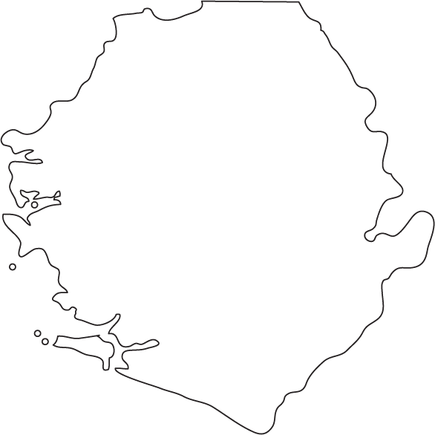

Beyond COVID-19
Access to Energy in Sierra Leone
Ministry of Energy
June 2021

Slide 2
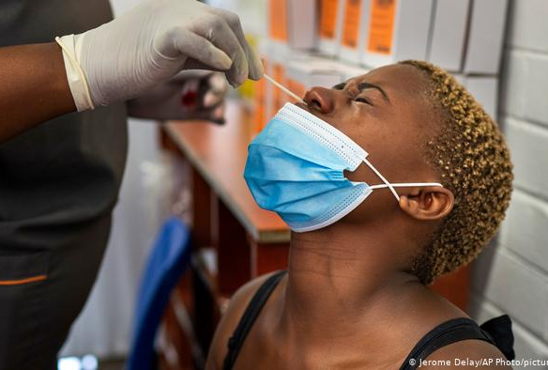
COVID-19 Impact
With the deterioration of economic activity over the past two years, the COVID-19 pandemic has aggravated a pre-existing crisis in energy and food security.
Food prices have risen substantially, and income losses by households has eroded coping capacities, by limiting household budgets for food and energy.
Implementation of Energy projects have been delayed due to the impact on shipping, , consultant availability, financing etc.

Slide 3
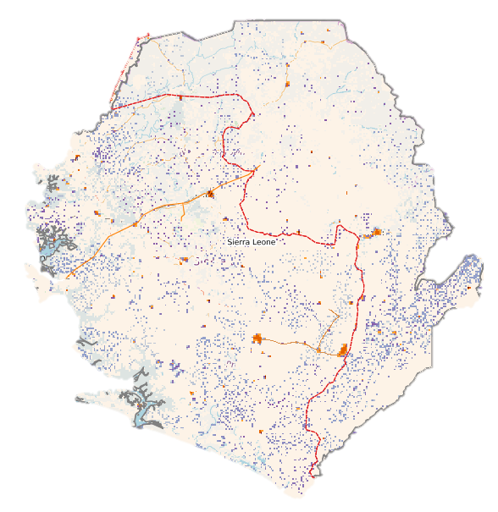
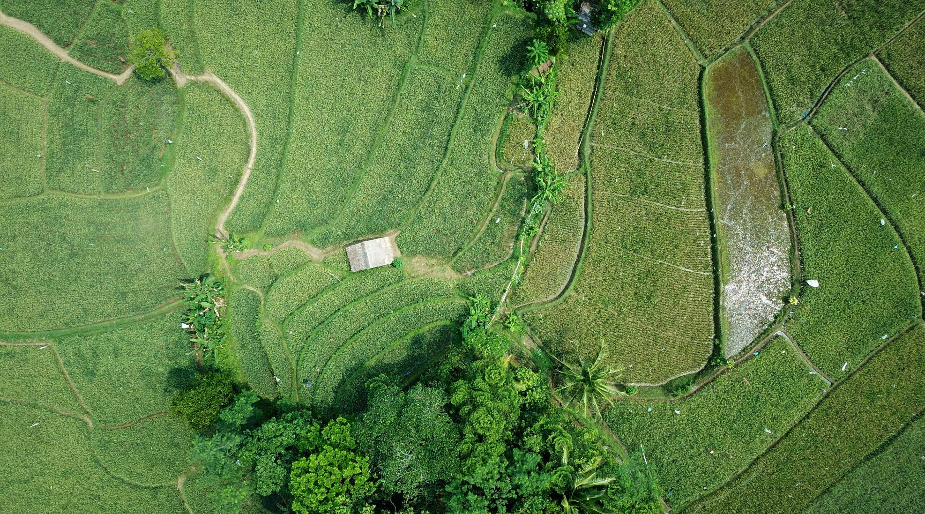
Population and Electricity Access
Kamakwie
Kabala
Bendugu
Kambia
Makeni
Koidu
Freetown
Magbruaka
Port Loko
Moyamba
Kailahun
Bo
Kenema
Bonthe
Pujehun
Town without Electricity
Town with Electricity

Slide 4
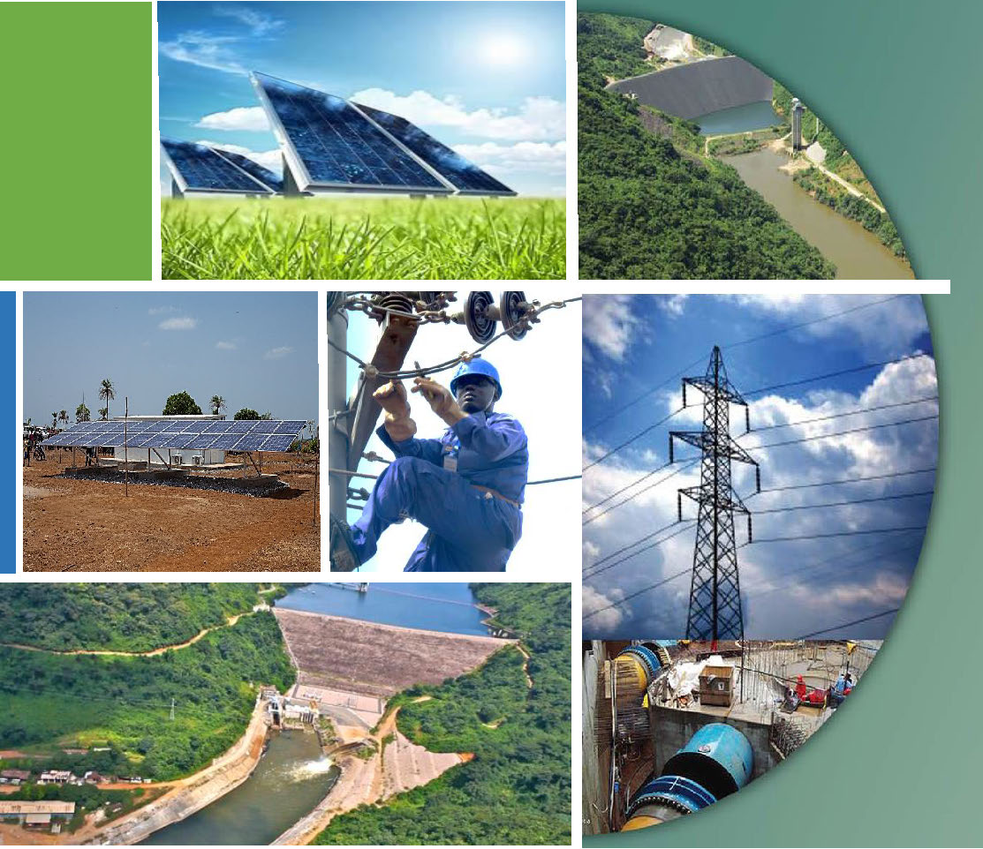
On-Going and Planned Solutions to Sector Challenges
2021 – 2025
Sector and Institutional Reform
Generation Projects
Transmission and Distribution Projects
Rural/Renewable Energy Projects

Slide 5
Sector and Institutional Reform
Project Summary and Status
Project | Status
Private sector intervention in EDSA | A Hybrid of Private sector capital, Development partner interventions and GoSL will provide the required output of affordable and sustainable energy to all Sierra Leoneans through a Least-Cost Energy Plan.
Transformation of EGTC | Full focus on Transmission and Dispatch Management. Consider leasing out all Generation assets to a private entity. Provide standby security power to the Freetown Network.
Establish a full Collection Account, | Work is ongoing. Required as part of the sustainability of the Sector. Will increase accountability and transparency.
National Electrification (Energy) Strategy | A National Electrification and Clean Cooking Strategy (NES) for increased access based on strong analytical works & mobilization of grant and/or concessional financing for implementation though donor coordination .
Establish a Rural Energy Directorate | To oversee access expansion in all provincial HQ. towns and rural areas: promotion of productive use, and electrification of schools and Community Health Clinics Continue to improve on commercial, regulatory and institutional arrangements to facilitate sustainable off-grid access, and to develop financing alternatives to encourage private investment.
Set up a Renewable Energy Fund | A proposed instrument for private, Donor Partner and government funds to be used for project development grants and tariff support.

Slide 6
Rural/Renewable Energy
Project Summary and Status
Kamakwie
Kabala
Project | Status
Selected communities in 194 chiefdoms
Rural Renewable Energy Project –97 Sites USTDA –Windgen feasibility will select 45 towns for new Mini Grids. Winch Energy – Feasibility study for additional 6 Locations. Powerleone - Feasibility study for additional 40 Locations. | Phase 1 completed with 54 Sites. Phase 2 in progress. Completion December 2021. Work is ongoing. Expected completion for report is September 2021 Work on-going. Expected completion in March of 2022. Negotiations on PPA underway. Expected financing and commencement in 2022.
WAPP / CLSG line Rural Electrification Component
Will connect 44 new towns/ villages, serving approximately 30,000 Households or 240,000 people. Installations complete in 25% of the selected towns.
Bendugu
Kambia
Makeni
Koidu
Freetown
Magbruaka
Port Loko
Moyamba
Kailahun
Bo
Kenema
Bonthe
Pujehun

Slide 7
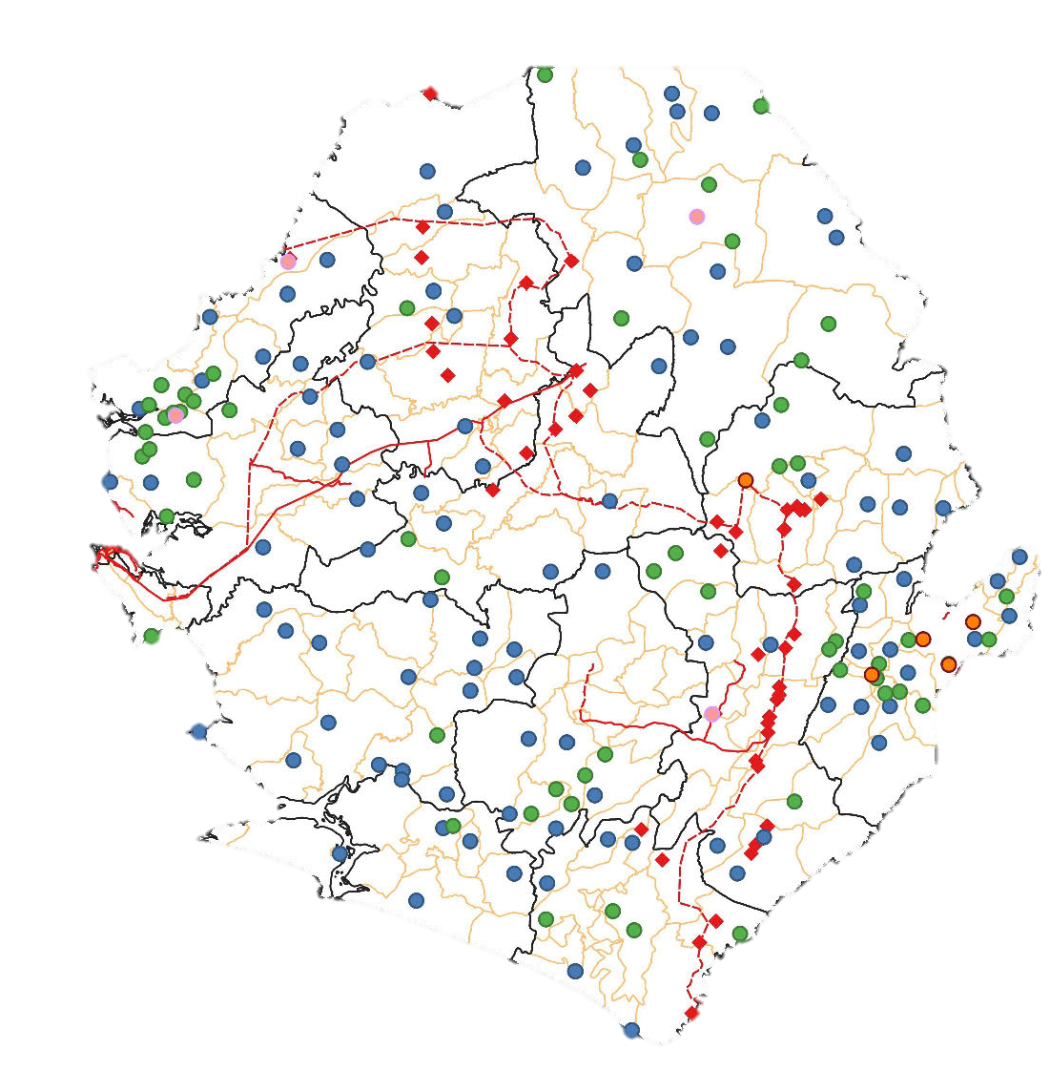
Rural/Renewable Energy
Project Summary and Status
Tariff issues
Tariffs for Mini-Grids are a main concern, as they are higher than that of main grid.
GoSL has approved a GST Waiver to reduce the impact on consumers.
Consideration is on-going for potential subsidy to bring costs in-line with those of urban citizens.
2021
100 Mini-Grids
280,000 People
2022
140 Mini-Grids
420,000 People
2024
220 Mini-Grids
800,000 People

Slide 8
Generation
Project Summary and Status
Generation | Status
Freetown Solar Park - 6MW | Work completed and commissioned.
Bumbuna II IPP - 143MW | PRG to be secured from AfDB. Seli Hydro will secure private financing in-lieu of GoSL grant and Concessional Loans. Financial Close in Q1 of 2022 Resettlement Action Plan in progress PPA/IA to be revised and reviewed
Western Area Generation Project IPP - 128 MW | Mielele Partners have secured financing from U.S. International Development Finance Corporation. Work to commence in December 2021. 2 year process for completion in 2023.
Bekonghor Hydro -160MW Located in Bekongor Falls upstream of Sewa River, Kenema District | Feasibility Study conducted for Design, finance, construct, install, operate, maintain and transfer of a 160MW Hydropower Electrical Plant (HEPP)
Planet Core Solar IPP – 50MW | MOU renewed in March 2021. Sites: Macouth and Bo
Solarera Installation - 5 MW | Privately financed. Installation to commence in Sept. 2021. Completion in Q1/2022.
Goma Hydro | Upgrade of Dam planned from 6 MW to 9MW. Funding alternatives being considered.

Slide 9
Transmission/Distribution
Project Summary and Status
Kamakwie
Kabala
Project | Status
Seven District Headquarter Town Electrification Bonthe Matru Jong Kambia Kailahun Kabala Moyamba Pujehun | GOSL has launched and funded EPC for distribution Networks in all towns. Generation and connectivity to Transmission Network is funded through the World Bank Enhanced Energy Project – Specifically for Kambia, Kailahun, Kabala, Moyamba and Pujehun. Evaluation of proposals for Engineering consultant underway.
Bo and Kenema - Rehabilitation and Expansion of Network and Transmission Line Project | In progress, expected completion in 2022. Design, Supply, Installation, and Commissioning of two primary substations and rehabilitation of two existing substations. Design, Supply, Installation, and commissioning of the Overhead Transmission Line between Bo and Kenema and rehabilitation of the distribution network in both towns. Supply and Installation of 50,000 Prepaid Energy Meters with service drops.
Bendugu
Kambia
Makeni
Koidu
Freetown
Magbruaka
Port Loko
Moyamba
Kailahun
Bo
Kenema
Bonthe
Pujehun

Slide 10
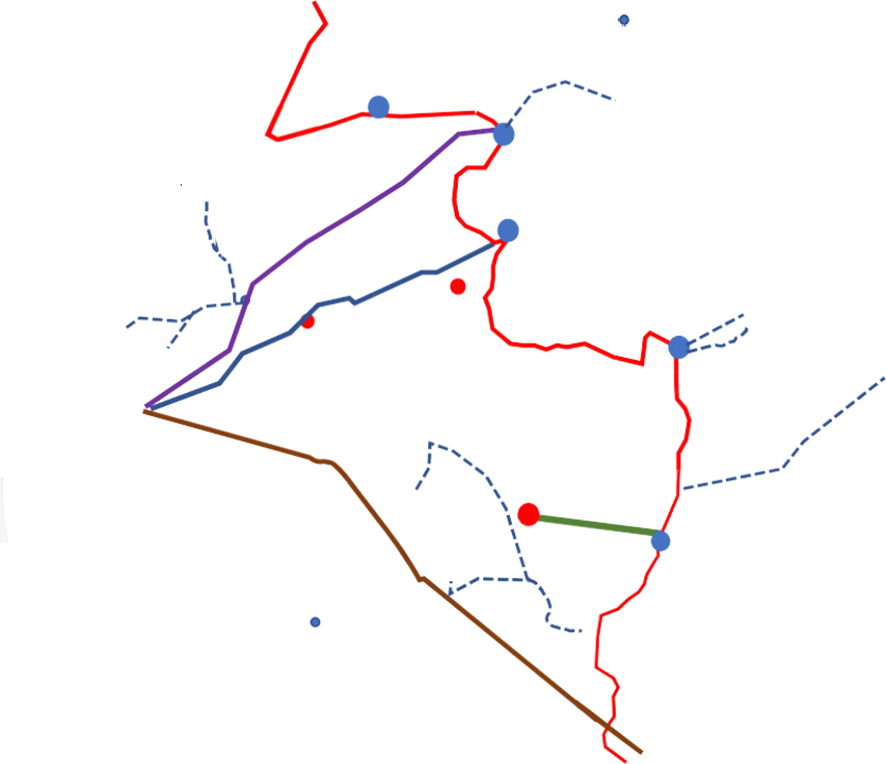
Transmission/Distribution
Project Summary and Status
Kamakwie
Kabala
Project | Status
3. Power imports – Cote D’Ivoire/Guinea via CLSG. Five Substations: Kenema, Bekongor, Bumbuna, Fadugu and Kamakwie | Transmission corridor and lines completed. 530 KM in Sierra Leone. PPA and TSA negotiations on-going. Interconnection to 161 KV Line completed Interconnection from Tilomah to Kenema in Progress
4. Nothern Transmission Line Project Bumbuna to Waterloo | Funded by India Exim bank - $78M Procurement for Project Management Consultant in Progress EPC Contractor List completed. Estimated Project Completion 2023
5. Construction of National Grid and Control Centre | A constituent part of the Northern Transmission Line. Will be located in Pa Loko.
Bekonghor to Koidu – 33KV | Funded by the World Bank. RFP in development for consulting services, site supervision and construction
Bekonghor to Octea Mining – 33KV | Execution stage (construction ongoing) To connect to OCTEA mining company.
Bendugu
Kambia
Port Loko
Makeni
Koidu
Freetown
Magbruaka
Moyamba
Kailahun
Bo
Kenema
Bonthe
Pujehun

Slide 11
Transmission/Distribution
Project Summary and Status
Kamakwie
Kabala
Project | Status
8. 66 KV Transmission line from Bandajuma : a. Through Baiima, Senehun, Taiama , Njala University and Mano b. Sumbuya/Sahr Malem through Gondama, Koribondo and Niagorehun. c. Koribondo to Pujehun | Feasibility Studies completed. Funding from World Bank DPF funds.
Energy Sector Utility Reform Project, (ESURP) | World Bank and GoSL Project Reinforcement, rehabilitation and expansion of the 11kV medium distribution grid network in Freetown. Rehabilitation of Primary Substations: and Construction of two new Primary Substations: Lumley and Clinetown. 60,000 Prepaid Energy Meters, Bulk Interface Metering System and Capacity Building will be provided.
Bendugu
Kambia
Port Loko
Makeni
Koidu
Freetown
Magbruaka
Moyamba
Kailahun
Bo
Kenema
Bonthe
Pujehun

Slide 12
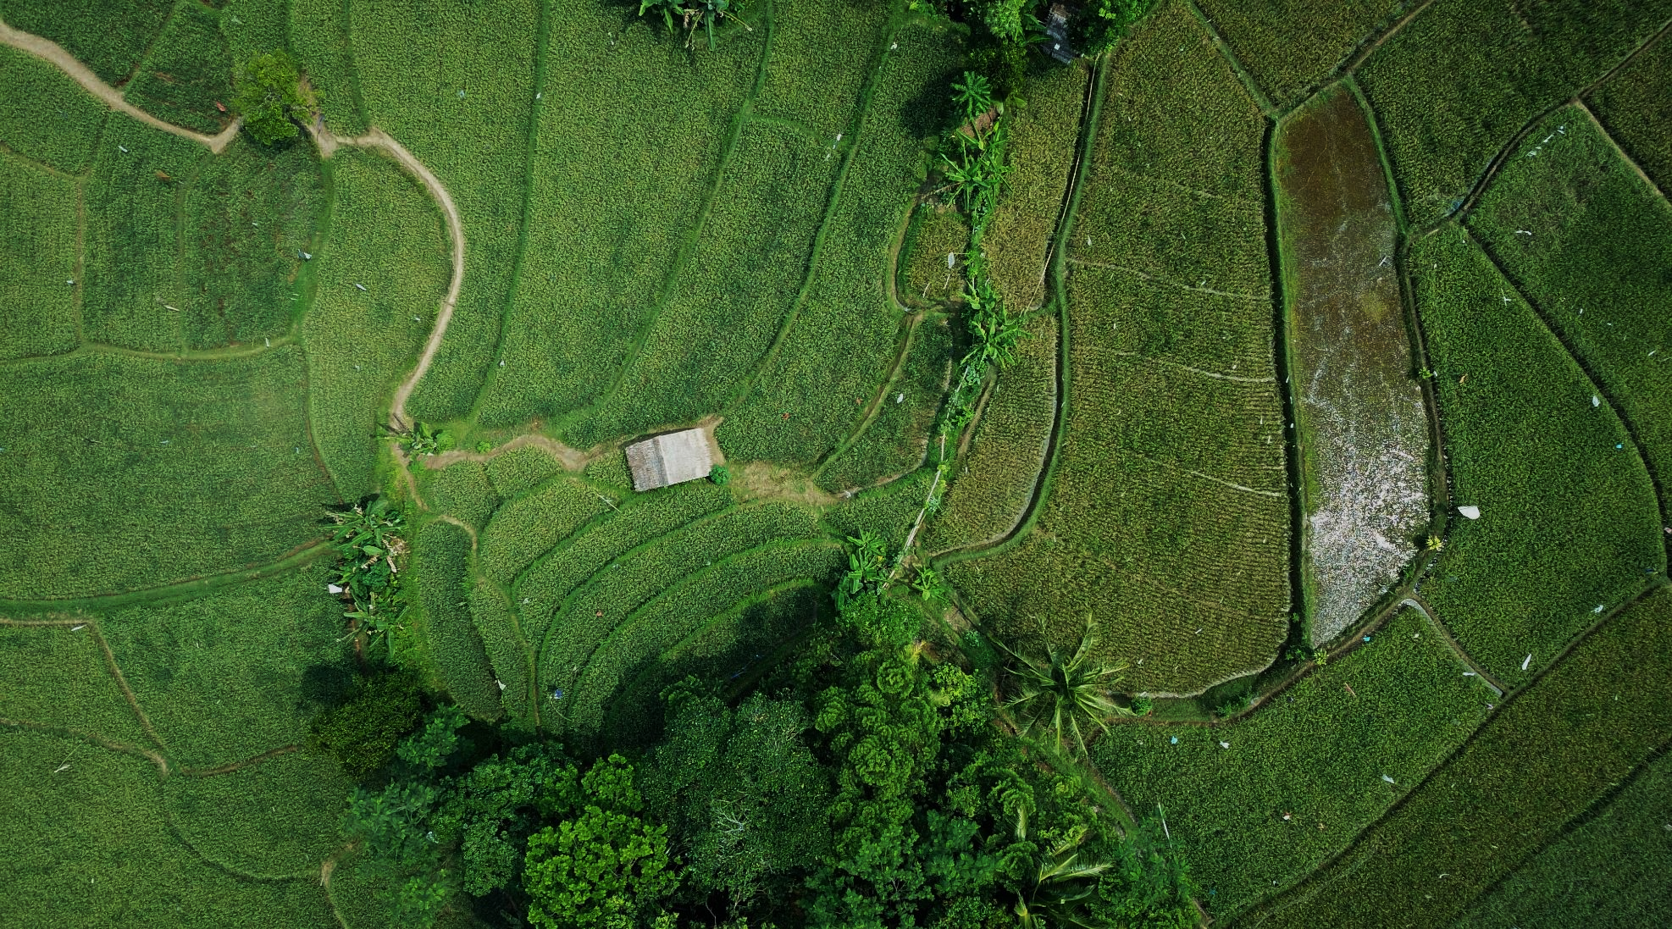




Post COVID-19, Energy Recovery Direction
Renewable Green Energy with Incentives and Regulation
Mini-Grid , Hydro Projects, Solar Home Systems – Tax Waivers etc
Increased Energy Access to benefit Rural populations
National Energy Strategy/Elect. Of District HQ/Increase in Mini Grids and Transmission Network
Promotion of Clean Cooking Strategies to reduce
deforestation and increase Household Health
National Energy Strategy/Clean Stoves Subsidy Roll out/LPG Infrastructure and Investment
Sustainable Projects with Private Sector Investment
Increase in Operators/Transformation of EDSA and EGTC/GoSL Investment in Network

Slide 13
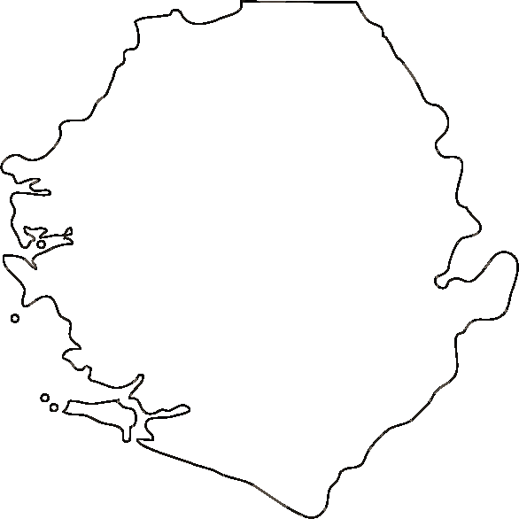


Post COVID-19, Critical Support Areas
Transmission and Distribution Network
Rural Energy Interventions for increased Access
Transformation and Private Sector Intervention in EDSA
Transformation and Private Sector Intervention in EGTC

Slide 14

Thank You
Ministry of Energy
Stronge Tower
3/3A Pademba Road
Freetown
For additional Information:
www.energy.gov.sl
www.energy.gov.sl/projects-2/

